Slide 1








Looking for the needle in the haystack
Evidence of the superforecasting hypothesis when time and samples are limited
.

Slide 2
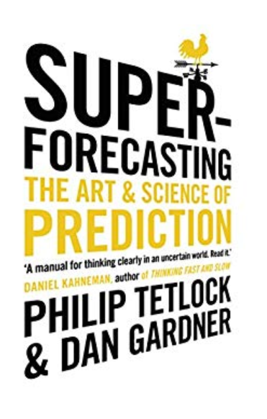

Slide 3
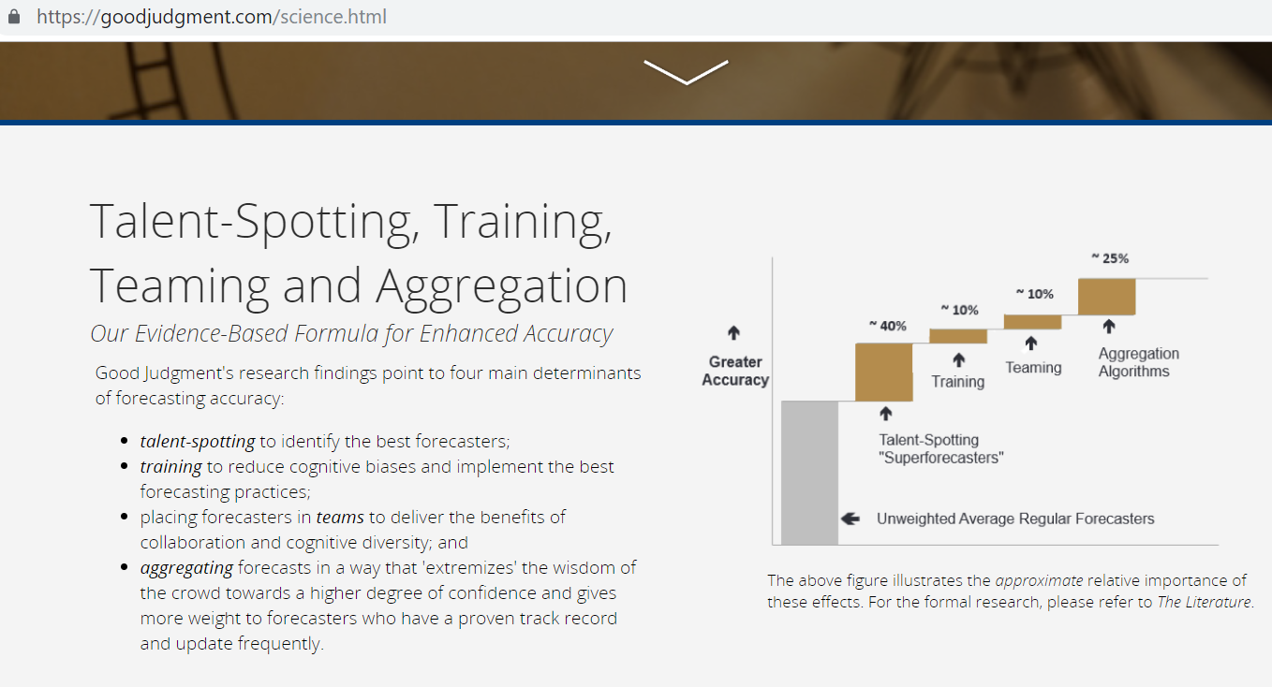

Slide 4
An interesting problem
and a
pragmatic angle to it…

Slide 5
REAL COMPANIES
Do not have time
Do not have resources (money or employees)
BUT
They do have difficult questions to answers – like BREXIT – so what would be the timeframe for that for a superforecasting experiment…??

Slide 6

What we do
Base our research on the groundbreaking results of the GJP
Focus on a smaller scale with more limited resources and fewer participants
Bridge Super-Forecasting with analogies
Analyze results:
Descriptive statistics
Stochastic Dominance
Structured Super-Forecasting
Notes:
Abstract
The success of the Good Judgmental Project in harnessing the power of superforecasting naturally leads to the question as to how one can implement that approach on a smaller scale with more limited resources and fewer participants. Small(er) corporate environments and SME-type decision structures are prime examples where the modified superforecasting approach can be used. In this research we focus on a hybrid approach of judgmental forecasting on special events where we combine training of superforecasters-to-be via the concept of a modified version of structured analogies, a staple of judgmental forecasting in the literature. We call the resulting approach structured superforecasting and illustrate its efficacy over samples of participants from the wider public sector and the academic community. In particular, with a proper experimental design that includes a training and a control group, we apply the above methodology and compare performances. Our analysis of the results utilizes, beyond standard measurement concepts of judgmental forecasting, the methodology of stochastic dominance (SD) to evaluate the performance of participants -- for the first time to the best of our knowledge in this strand of the literature. The use of the SD concept is important for two reasons: first, it allows a complete/better view of outperformance compared to more traditional statistics and, second, it provides compelling visuals for the results across individual questions and across any sample split we wish. We find that, across most questions employed, analogies trained participants outperform the control group. This is an important and practical result which we validate for the first time. The implications of extending this research in other environments and different samples is obvious: expending effort and resources in training on analogies can super-charge super forecasting and thus tapping into the wisdom of the crowds does not need larger crowds but, importantly, smarter (by training) ones.

Slide 7
Hypotheses
Η1: Under the strict constraint of sample size (number of forecasters) and time (duration of experiment) we find evidence of the superforecasting hypothesis
Η2: The structured approach for providing forecasts outperforms the unstructured - unaided one (training works).
H21: there will be more superforecasters in the extra-trained group
Structured Super-Forecasting

Slide 8
Motivation
The ambiguity to which the decision making process is exposed.
The over-perfomarnce of the GJP approach
The motivation to derive to a more simplified approach by narrowing down the alternative forecasting methods, within the SF framework and focusing to SAs
The intrinsic constraints of manpower and time
Structured Super-Forecasting

Slide 9
Research Layout
Structured Super-Forecasting
Notes:
The research was built on the foundations of the Good Judgment Project (P. E. Tetlock et al., 2014; Philip Eyrikson Tetlock & Gardner, 2015; Ungar et al., 2012). Best practices already identified and verified therein (eg. the effectiveness of statistical reasoning and debiasing in providing more accurate forecasts) were considered as facts (and left intact) and further modifications were made in order to derive to alternative “profitable” approaches.
In other words, we implemented Occams’ Razor (Simon, 1979), in terms of accepting the simplest theory that works and elaborating further on, by utilizing particular methods in suitable context (Gigerenzer, 1996).
The project had the form of a forecasting tournament, and was conducted between November 2016 and July 2017. Participants were asked to submit their subjective probability estimates for a variety of time bound questions, by using a custom designed web interface. The project was primarily divided into two phases. During the first phase, all participants were split into two groups (control and trained) and were asked to provide their forecasts on their own, without interaction between them. The second phase included team work, and the participants of each of the aforementioned groups formed teams of three and were asked to provide their individual forecasts after having anonymously collaborated with the other team members.
The present paper analyses only the outcomes of the first phase.
Subjects were recruited primarily from the wider public sector and academia. Recruitment took place from August 2016 to October 2016, and had the form of an informative (face to face) presentation, where a clear view of the project layout was described, along with several examples of what potential participants were up against. All participants, upon admission to the project had to create a new email address in the form of w123456@provider.com (a letter followed by 6 numbers of their choice) which would be their user name. Our purpose was to protect anonymity within the project environment, and thus limit potential influences amongst participants. Following that, all participants had to go through a thorough demographics quiz, and then randomly be allocated in one of the two project teams, as follows: a) Team “A”: Control Group, b) Team “B” Trained Group.

Slide 10
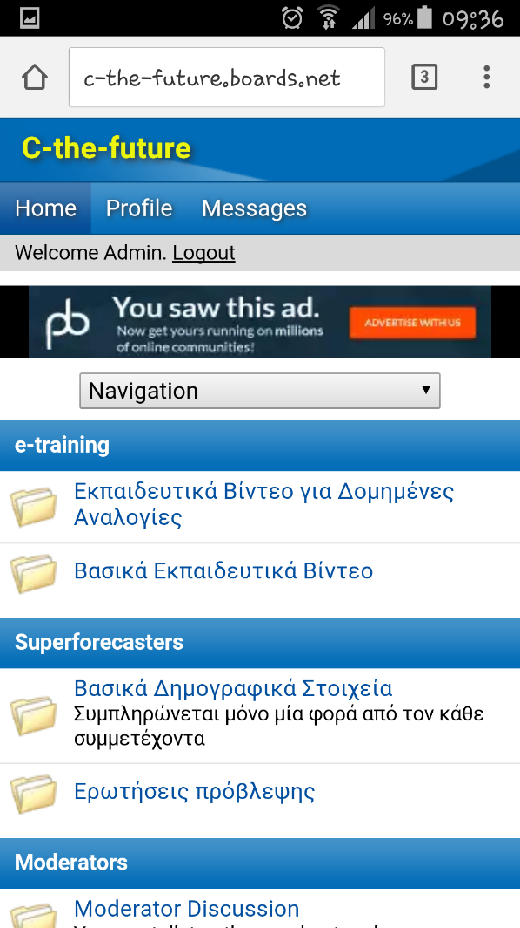
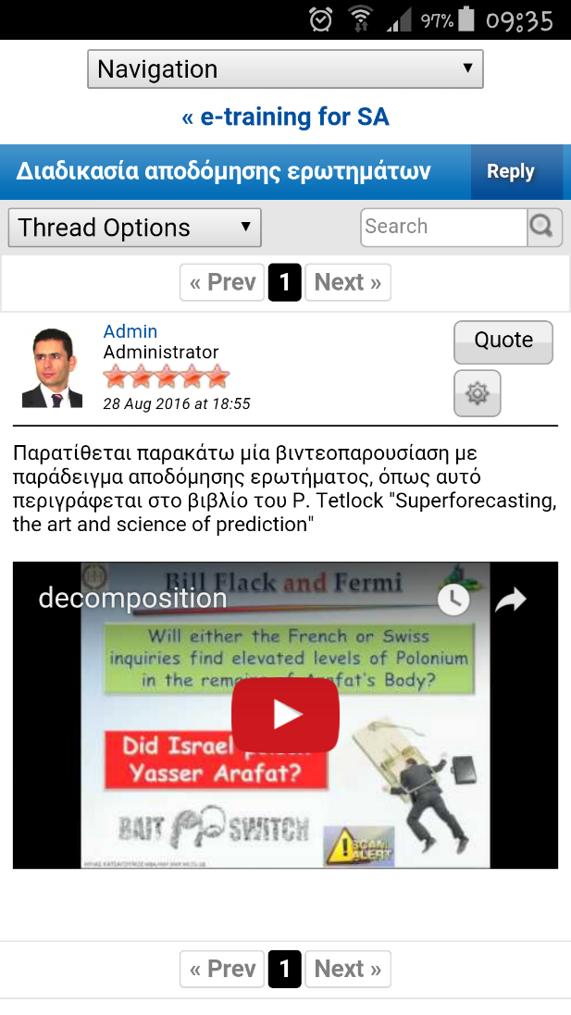
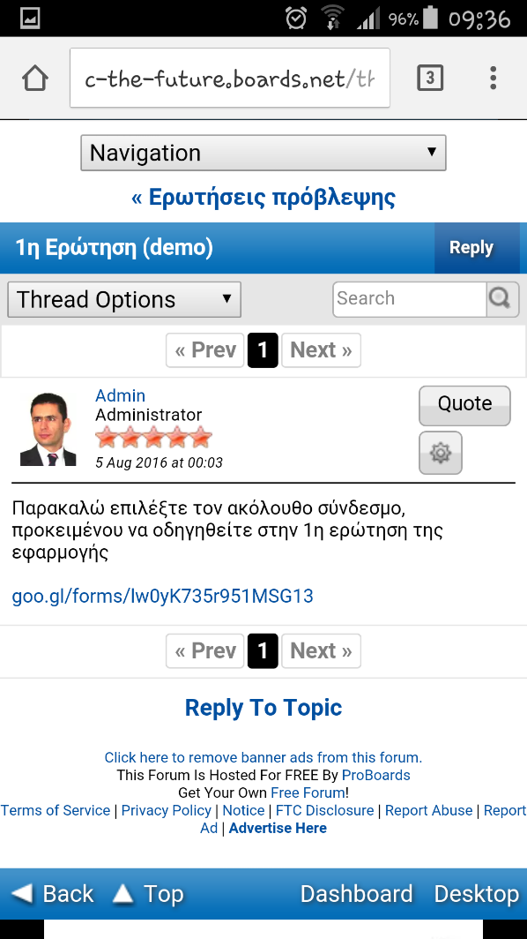
Web Interface
URL: http://c-the-future.boards.net/
Mobile version
Structured Super-Forecasting
Notes:
More than 90% of the audience was from Greece.
Those from abroad were native speakers of the Greek language
(The forum is locked…. They will not be allowed to get in…)

Slide 11
Training
Structured Super-Forecasting
Notes:
Was based on the GJP and expanded to cover the needs of the current projects
Several examples were drawn from the Book “Superforecasting”, eg the one with Yaser Arafat being poisoned with polonium
The training design followed the principles of the Good Judgment Project (Chang et al., 2016). In practical terms, all participants, were randomly distributed into two groups: a) Team “A”: No Analogies, b) Team “B”: With Analogies. The training modules per group, are presented on the slide
The construction of the training modules was an arduous effort, and had to go through several revisions. Initially a small survey was performed, to a sample of the participants (in the form of unstructured interviews), in order to derive to the optimal duration of the presentation modules with the objective to obtain maximum engagement.
The above survey verified the concept of “microlearning” (Hug, 2007; Katsagounos & Rehrl, 2018) and an approximate duration of 10΄ per module was selected as the rule of thumb.
Following the above duration “restrictions”, a severe content compression had to be performed in order to achieve optimal training material communication, both in terms of content completeness and comprehension.
Post training interviews were performed, that verified the effectiveness of the above approach in terms of content engagement, as an outcome of content comprehension and applicability.
It is a fact that a solemnly didactic approach is not always the most fruitful, principally due to one-way communication (Chang et al., 2016; Graber, 2003). Participants were therefore receiving active feedback in the form of a Brier Score (Brier, 1950) for each question, along with their respective comparative performance ranking, relatively to the other participants. The above information, along with a continuous prompt to go through the training material before engaging to a question, was aiming to help them re-calibrate their forecasting methods and adapt towards achieving a better performance. According to (Barbara Mellers et al., 2014) training effects were identified to last to training periods (8-10 months duration per period).
-----------------------------------------------------------------------------------------
Each team had access to its dedicated training courses by using a specific PW

Slide 12
The questions
Will the United States of America submit by May 30th 2017 an official request to withdraw from the United Nations Framework Convention on Climate Change (UNFCCC)?
Structured Super-Forecasting
Notes:
All questions used for the purposes of the present project, were carefully selected by an appointed team (selection board) comprised of the three writers of the present paper and carefully selected subject matter experts, depending on the topic of each question.
In practical terms, the selection board had each question formulated in a very clear layout, ruling out any information that would potentially guide the forecasters towards a specific direction. Furthermore a “Clairvoyance test” was issued for each question, which prevented potential “ex postfacto” disputes for the actual outcome of the question at hand (B. Mellers et al., 2015).
On the slide we present an example of one of the questions given (translated from Greek to English):

Slide 13
The questions
According to Article 25 of the aforementioned Framework Convention, “…withdrawal shall take effect upon expiry of one year from the date of receipt by the Depositary of the notification of withdrawal...”.
Verification of withdrawal request submission will be performed through the UN’s respective official site:
https://treaties.un.org/Pages/CNs.aspx?cnTab=tab1&clang=_en.
Supplementary information concerning UNFCCC can be retrieved from the Hellenic Ministry’s for Environment and Energy official website at:
http://www.ypeka.gr/Default.aspx?tabid=226&locale=el-GR&language=en-US
http://www.ypeka.gr/LinkClick.aspx?fileticket=%2bZ9LThYNEvI%3d&tabid=442&language=el-GR
Structured Super-Forecasting
Notes:
Apart from the question text, several other supplementary clarifications were given to participants, primarily through the use of “neutral” resources (UN, EU, governmental entities etc).

Slide 14




Literature Review
De-biasing
Forecasting
Scoring
Judgmental Forecasting
(Super) forecasting
By Analogies
Structured Analogies
S. Structured Analogies
Brier Scores
Data normalization
Bootstrapping
Stochastic Dominance
Structured Super-Forecasting
Notes:
The literature review is primarily focused in three thematic areas: De-Biasing, Forecasting & Scoring
The Director of National Intelligence (DNI) is the United States government official – subject to the authority, direction, and control of the President – required by the Intelligence Reform and Terrorism Prevention Act of 2004 to:
Serve as principal advisor to the President, the National Security Council, and the Homeland Security Council about intelligence matters related to national security;
Serve as head of the seventeen-member United States Intelligence Community; and Direct and oversee the National Intelligence Program.
Αποτυχία 2001 με δίδυμους πύργους
Αποτυχία 2003 με πυρηνικά στο ΙΡΑΚ. http://www.newser.com/story/164620/us-uk-knew-iraq-had-no-wmds-report.html
IARPA's mission [is] to invest in high-risk/high-payoff research programs that have the potential to provide the United States with an overwhelming intelligence advantage over future adversaries."
Οργάνωσε ένα μεγάλης κλίμακας τουρνουά σχεδιασμένο να καταγράψει την ακρίβεια ποσοτικών (με πιθανότητα) εκτιμήσεων για την πρόβλεψη σημαντικών γεγονότων ανά τον κόσμο
Συμμετείχαν 5 οργανισμοί και το διαγωνισμό για 2 συνεχόμενα χρόνια τον κέρδισε με διαφορά το πανεπιστήμιο της Πενσιλβάνια με καθοδηγητή τον Philip Tetlock.
There are many cases where judgmental forecasting is the only option, such as when there is a complete lack of historical data, or when a new product is being launched, or when a new competitor enters the market, or during completely new and unique market conditions.
Bill Flack. He’s retired from a job with the U.S. Department of Agriculture, has a bachelor of science from the University of Nebraska and likes bird watching.
Flack and his fellow superforecasters represented the top two per cent of all volunteers in the tournament. They outperformed an official control group by 60 per cent in the project’s first year and also performed about 30 per cent better than intelligence community analysts with access to classified information. The very best of the superforecasters were even able to beat prediction markets, where traders bet real money on futures contracts based on the same questions, by as much as 40 per cent.

Slide 15
Literature Review
De-biasing
De-biasing
Didactic
Format Based
Process Based
Feedback Based
Structured Super-Forecasting
Notes:
Given the human mind principally (~95%) works on intuitive mode (Lakoff & Johnson, 1999) we have a natural tendency to use heuristics in order to save time and effort (Tversky & Kahneman, 1974).
Those systematic errors, are called biases (Kahneman, 2013) and the number of them is quite immense (Montibeller & von Winterfeldt, 2015).
Biases, are therefore inherent in human judgment, and not necessarily with a strictly negative meaning. They are meant to serve specific needs that have helped the human species to survive throughout the ages (Kahneman, 2013).
Nevertheless, those biases occasionally hinder the decision making process, given they primarily rely on automated mental mechanisms.
Those biases, are principally “Type 1” errors (outcomes of intuitive processes), that drive the decision making process.
Although Type 1 prevails in the bias world, we should not rule out Type 2 errors (those deriving from slow systematic thinking), that might be the outcome of erroneous strategy selection or imperfect decision rules (Arkes, 1991).
The key to counteracting biases, is debiasing. In a vary recent paper (Chang, Chen, & Mellers, 2016) that summarizes the impact of various training practices on judgmental accuracy in geopolitical forecasting tournaments, debiasing techniques, are organized into four major categories: a) didactic, b) process based, c) feedback based and finally d) format based.
The effectiveness of each of the above techniques is not the same, yet their combination can lead to enhanced levels of performance, in terms of mitigating or even out-ruling biases.

Slide 16


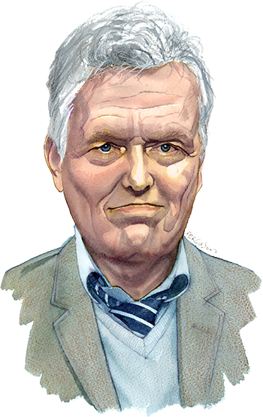
Literature Review
1st Year:
60% better than control group
2nd Year:
80% better than control group
The rest of the teams were reliesed by IARPA
JF & SF
Structured Super-Forecasting
Notes:
The research on the topic of judgmental forecasting is quite immense (M. Lawrence, Goodwin, O’Connor, & Önkal, 2006). Furthermore, there exists several studies that compare the relative performance of judgmental forecasting to the statistical one, with outcomes varying, in a case by case state (Carbone & Gorr, 1985; M. J. Lawrence, Edmundson, & O’Connor, 1985; O’Connor, Remus, & Griggs, 1993; Sanders, 1992).
In a corporate environment, it has been proven that expert management judgement (expressed as a forecast) has significant importance for the company’s decision making process (Fildes & Goodwin, 2007), either as a form of adjustments to statistical forecasts (Fildes, Goodwin, Lawrence, & Nikolopoulos, 2009) or as a standalone process in conditions where either there is no historical data, or it is chosen that historical data and/or statistical forecasts should be ignored (Franses & Legerstee, 2010).
To sum it up, based on the findings of (Makridakis, Wheelwright, & Hyndman, 1998) it can be considered that the judgmental approaches are very helpful but their relative effectiveness, is tangled to a number of limitations, with the most salient being the forecaster’s inherent biases.
The more recent findings on Judgmental Forecasting, came from a wide research sponsored by IARPA (Intelligence Advanced Research Programs Activity), in the form of a series of geopolitical forecasting tournaments, which managed to shed light on the strategies being used for making intuitive probability judgments. Particularly, throughout its four-year duration, the “Good Judgment Project” (Office of the Director of National Intelligence, 2017; Philip Eyrikson Tetlock & Gardner, 2015) team from Wharton University, managed to prevail in all four consecutive years, and its approach is considered a “lighthouse” in the recent scientific literature.
The key findings of the above research present as reinforcing explanations of the “superforecasting” performance four principal elements: (a) cognitive abilities and styles, (b) task- specific skills, (c) motivation and commitments and (d) enriched environments (B. Mellers et al., 2015).
Furthermore, it designates the following key (psychological) drivers of accuracy: (a) recruitment and retention of better forecasters, (b) cognitive de-biasing training, (c) more engaging environments in the form of teamwork and prediction markets and (d) better statistical methods (P. E. Tetlock, Mellers, Rohrbaugh, & Chen, 2014).
At this point we should not put aside a prior study conducted by P.E. Tetlock, where he focused on judgmental shortcomings. He clearly portrays “experts”, or pundits in some cases, as no better in making long term predictions than most people. Furthermore, he pin-points the luck of accountability as a critical contributor to the propagation of bad forecasts (Gardner, 2011; Philip E. Tetlock, 2005).

Slide 17
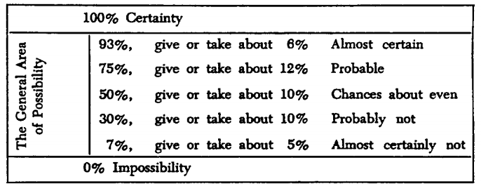
Literature Review
Basic Papers:
Kent, Sherman. “Words of Estimative Probability.” [Washington, D.C.]: Center for the Study of Intelligence, Central Intelligence Agency, 1993

Slide 18
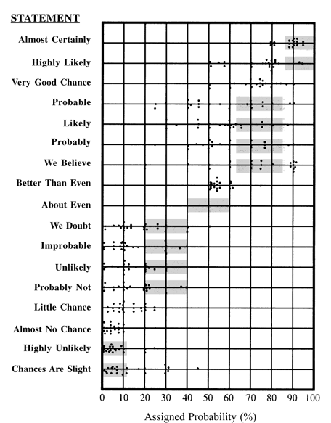
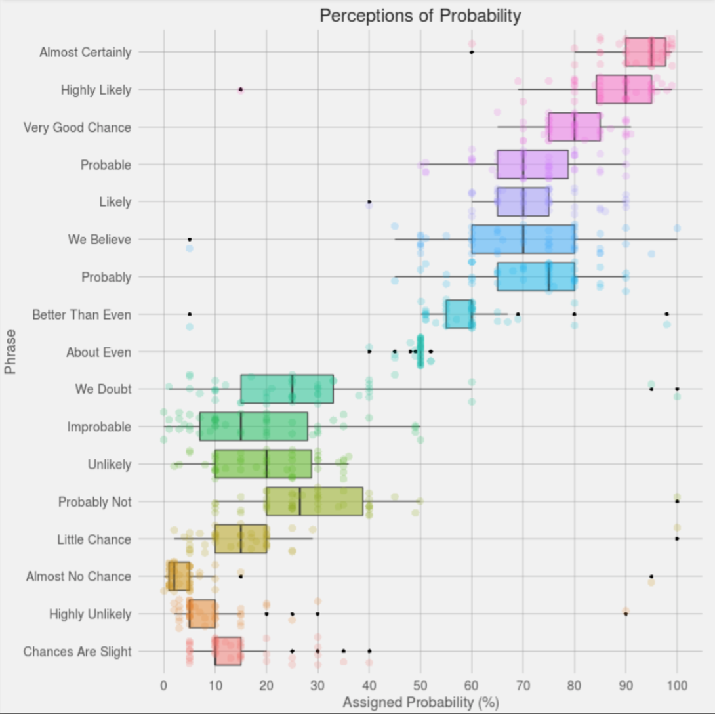
Literature Review
Basic Papers:
Heuer, R. “Psychology of intelligence analysis”. [Washington, D.C.]: Center for the Study of Intelligence, Central Intelligence Agency, 1999
Structured Super-Forecasting
Notes:
https://blogs.sas.com/content/iml/2017/05/03/perceptions-of-probability.html#prettyPhoto
In the book Psychology of Intelligence Analysis (Heuer, 1999), the author presents "the results of an experiment with 23 NATO military officers accustomed to reading intelligence reports. They were given a number of sentences such as: "It is highly unlikely that ...." All the sentences were the same except that the verbal expressions of probability changed. The officers were asked what percentage probability they would attribute to each statement if they read it in an intelligence report."
The results are summarized in the adjacent dot plot from Heuer (Chapter 12), which summarizes how the officers assess the probability of various statements. The graph includes a gray box for some statements. The box is not a statistical box plot. Rather it indicates the probability range according to a nomenclature proposed by Kent (1964), who tried to get the intelligence community to agree that certain phrases would be associated with certain probability ranges.
For some statements (such as "better than even" and "almost no chance") there was general agreement among the officers. For others, there was large variability in the probability estimates. For example, many officers interpreted "probable" as approximately a 75% chance, but quite a few interpreted it as less than 50% chance.

Slide 19
Literature Review
Basic Papers:
Laurence, Michael, Paul Goodwin, Marcus O'Connor, and Dilek Oncal. "Judgmental forecasting: A review of progress over the last 25 years." International Journal of forecasting, 2006: 493-518.
Mellers, Barbara, et al. "Identifying and Cultivating Superforecasters as a Method of Improving Probabilistic Predictions." Perspectives on Psychological Science, 2015: 267-281
Mellers, Barbara, et al. "The psychology of intelligence analysis: Drivers of prediction accuracy in world politics." Journal of Experimental Psychology, 2015: 1-14.
Tetlock, Philip, and Dan Gardner. “Superforecating: The art of science and prediction”. New York: Crown Publishers, 2015.

Slide 20
Literature Review
Basic Papers:
Tversky, Amos, and Daniel Kahneman. "Judgment under Uncertainty: Heuristics and Biases." Science (New York, N.Y.), 1974: 1124-31.
Armstrong, J. (2001). Principles of Forecasting: A Handbook for Researchers and Practitioners (International series in operations research & management science). Springer.
Savio, N. and Nikolopoulos, K. (2013). “A strategic forecasting framework for governmental decision-making and planning”. International Journal of Forecasting, 29(2), pp.311-321.
Nikolopoulos, K., Litsa, A., Petropoulos, F., Bougioukos, V. and Khammash, M. (2015). “Relative performance of methods for forecasting special events”. Journal of Business Research, 68(8), pp.1785-1791.

Slide 21
Str. Super-Forecasting
METHOD | SA | s-SA | SS-Forecasting
Administrator use | High | Medium | Low
Administrator role | • Define problem • Define potential alternative outcomes • Define forecast | • Define problem • Define potential alternative outcomes | • Define problem (set question)
Means for collecting responses from participants | Hard Copy/e-mail/Fax | Hard Copy/e-mail/Fax | Web platform
Problem description- formulation | Exhaustive | Exhaustive | Simple forecast question
Number of participants | Minimum 5 SMEs | 5 to 10 SMEs | No restriction
Forecaster domain expertise | Prerequisite | Prerequisite | Desired
Provided training to participants | Non | Non | Relatively detailed e-training (short video tutorials aiming at providing focused knowledge through the use of examples)
Minimum number of analogies | 2 | 1 | Forecaster’s discretion
Structured Super-Forecasting

Slide 22
Str. Super-Forecasting
METHOD | SA | s-SA | SS-Forecasting
Time for participants to respond | Not defined | 1 week | 1 week for initial forecast and then unconstraint for consecutive forecasts
Number of responses | 1 | 1 | Not restricted (multiple forecasts allowed)
Problem decomposition | Non | Non | Yes (if desired)
Participant’s response formulation | • Analogy description • Source of analogies • Similarity rating (1-10) • Closest outcome from given selections (ability to use %) | • Analogy description • Source of analogies • Similarity rating (1-10) • Closest outcome from given selections in the form of a prediction interval • Point forecast from within the above selected prediction interval | • Question decomposition (if necessary) • Analogy description (for all, or some of the decomposed levels) • Source of analogies (URL or text) • Similarity rating (1-10) • Point forecast in the form of a probability expression
Forecast extraction | By administrator using a predefined set of mechanical rules | By participant, providing point forecast from within the pre-selected prediction interval | By participant, providing point forecast
Structured Super-Forecasting

Slide 23

Data Collection
Source: Field Research
Period: 11/2016 - 5/2017
Participants: 110-220
No of Observations:
14 questions, open for 2-6 months
120-280 answers per question
~2100 registrations
Structured Super-Forecasting
Notes:
The number of participants was variable per question, having a pick during the first 3 weeks, and then standardizing approximately around 110-120

Slide 24
Incentives
“Certification for the Successful Participation in a Research Program in the Field of Judgmental Forecasting”, issued by the University of Peloponnese.
The opportunity to attend, free of any a cost, a hyper-intensive preparatory course towards obtaining the Project Management Professional (PMI/PMP©) certification, of nominal value of 650.00€.
Structured Super-Forecasting
Notes:
In the initial presentation given to all participants, during the recruiting process, the following incentives were communicated to them:
A “Certification for the Successful Participation in a Research Program in the Field of Judgmental Forecasting”, issued by the University of Peloponnese.
The opportunity to attend, free of any a cost, a hyper-intensive preparatory course towards obtaining the Project Management Professional (PMI/PMP©) certification, of nominal value of 650.00€.
Information on the specific certification can be retrieved from: www.pmi.org/certifications/types/project-management-pmp. Practically they were given the chance to obtain one of the most important industry-recognized certifications for project managers.
To qualify for the incentives, participants had to make a forecast for at list 11 out of the 14 questions of the first phase

Slide 25





Method & Tools
Methodologies:
Descriptive Statistics
Visual representations
Bootstrapping (as an intermediate tool for…)
Stochastic Dominance
Software:
ProBoards (private forum)
YouTube (asynchronous e-training)
Google Forms (data collection)
R (data manipulation-analysis)
Boxplots
Cumulative graphs
Structured Super-Forecasting

Slide 26
Scoring
Structured Super-Forecasting
Notes:
The traditional Brier Score was used in order measure performance accuracy (Brier, 1950). In simple terms the Brier Score measures the squared deviations between probabilistic point forecasts (as expressed by the participants) and actual outcomes (as verified and codded by the selection board). A principal characteristic of Brier scoring is that extremely erroneous forecasts are heavily penalized. The actual outcomes have a binary expression, either of “0” if the event under question did not occur, or “1” if the event took place. All participants were receiving Brier-based scores and their corresponding ranking, as follows:
Average Brier Score for each question, where a forecaster gets a score for each day a question is active, starting from the time that he actually places his first point forecast (Horowitz et al., 2016).
In the example (1st table), a forecaster who was participating to a question that was active for 42 days, placed three consecutive forecasts, on the 2nd, 20th and 41st days. In order to take into account, the moment each forecast is being placed, each forecast is being “carried along” until the moment a new one is placed. This assumption is logical given the most probable reason a forecaster is not updating his forecast is because he actually still believes in its validity. So the score for the above question would be: (20*0.32+22*0.08+2*0.0002)/41=(6.4+1.76+0.0004)/41≈0.199.
--------------------
Average Net Brier points (NBP) for each question, while taking into account the performance of other forecasters at the time each forecast was being placed. Particularly, we average all the Brier scores per day (benchmark Brier), for all the active participants in the specific question, and we then subtract them from the forecaster’s daily score (individual scores):
The specific Scoring method was retrieved from the Open Good Judgment tournament at: http://training.goodjudgment.com/keepingscore/index.html.
Given the above, NBP, ideally take values in [-2,2], and being in the range [-2,0), indicates that the forecaster performs better than average, with the lowest NBP indicating better performance. So, in the present example, NBP, would be calculated as the average of the Net Briers, in a 42 days period (NBP ≈ -0.45).
NBP=[0+(-0.67)+(-0.66)+(-0.65)*18+(-0.63)+(-0.32)+(-0.24)*20+(-0.1098)+(-0.0008)]/42 ≈ -0.45

Slide 27
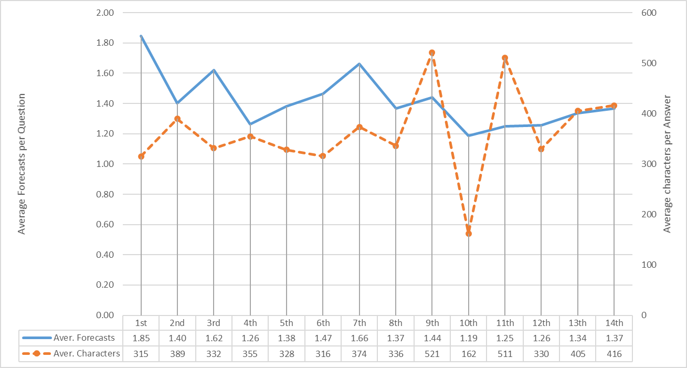
Data Collection
-0.531 <= Correlation shift =>0.317
Structured Super-Forecasting
Notes:
In general, the participant’s engagement with the whole endeavor could be characterized as balanced and relatively anticipated. In particular, the average forecast update, per participant and per question was 1.42 [in the GJP the corresponding frequency was 1.49 (Friedman, Baker, Mellers, Tetlock, & Zeckhauser, 2015)]. Furthermore, given the experiment procedures required justification for all questions, the corresponding character count is relatively high, averaging at 363 characters per person and per question [The corresponding restriction in the GJP was that there should be at list one 50 word (~200 characters) comment throughout the year (B. Mellers et al., 2015)].
In the below chart, we provide the evolution of the previous mentioned characteristics throughout the progression of the experiment. The correlation coefficient for the above characteristics was estimated at 0.06, indicating that they are almost absolutely uncorrelated. Conversely, a closer look at the below graph clearly indicates that they are correlated, with the correlation coefficient drastically changing after the 6th question. Particularly, the coefficient for the first 6 questions is -0.531, and for the rest is 0.317.

Slide 28

Hypotheses “1” Testing
Η1: Under the strict constraint of sample size (number of forecasters) and time (duration of experiment) we find evidence of the superforecasting hypothesis
Structured Super-Forecasting

Slide 29
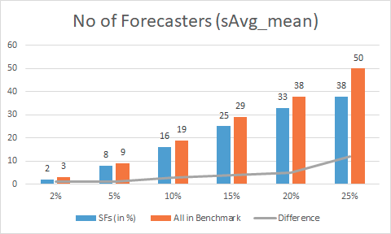
Analysis & Findings
Structured Super-Forecasting
Notes:
In order to test the validity of our 2nd hypothesis, we set as a cut-off point the 6th question, which is the median of our acceptance threshold (11 out of 14 questions to be answered) and we identify, at that point, the forecasters that belong to the top 2% (check validity of Superforecasting theory in the present experimental outline), 5%, 10% and 25% (top quartile) and see who among those remain within the specific pool or we face randomness in performance (time tracking of performance).
We provide below a visual analysis of the above described performance through the following metrics:

Slide 30
Analysis & Findings
Early Identifiers
Gender | The test identified significant difference in performance (Χ2(1)=4.808, p<0.05) between males (24.2% in the 25% bin) and females (11.3% in the 25% bin).
Structured Super-Forecasting
Notes:
Early Identifiers
The constraints under which the present experiment was conducted (time and participants) resulted to a relatively limited data for profound analysis and evaluation. To maximize the sample data, in order to derive to trustworthy conclusions, we conducted further analysis of the forecasters belonging in the 25% bin (38 people), irrespective of the team within which they belonged, by comparing their demographic characteristics with the rest of the participants (157 people). Below are presented the key profile characteristics that differentiate them from the rest of the participants.
They were identified through the use of Pearson’s Chi Square independence test

Slide 31
Analysis & Findings
Early Identifiers
Working experience | The test identified significant difference in performance (Χ2(6)=19.04, p<0.05) for the various levels of experience. Particularly, from the various experience levels, the greatest contributing percentage (40% in the 25% bin) comes from those with 16-20 years of experience, whereas the lowest (7.8% in the 25% bin) from those with no experience (principally academia).
Structured Super-Forecasting

Slide 32
Analysis & Findings
Early Identifiers
Knowledge of the English language | The test identified significant difference in performance (Χ2(2)=7.31, p<0.05) for the three levels of English language knowledge. Particularly, the greatest contributing percentage (25% in the 25% bin) comes from those with expert knowledge. Those with the intermediate knowledge contributed with 12.3%, whereas those with basic knowledge had no contribution at all.
Structured Super-Forecasting

Slide 33
Analysis & Findings
Early Identifiers
General frequency of information | The test identified significant difference in performance (Χ2(4)=9.98, p<0.05) for the various levels of information frequency. Particularly, the greatest contributing percentage (31.8% in the 25% bin) comes from those that get informed on a daily basis. The contribution was declining in an almost linear fashion: 20.9% (weekly), 14.3% (monthly), 3.6% (more scarce), 0% (never).
Structured Super-Forecasting

Slide 34
Analysis & Findings
Early Identifiers
Type of information sources | The participants were requested to denote their principle sources of information. The choices provided where: (1) paper-based periodical publications, (2) internet-based periodical publications (including official websites), (3) independent websites (bogs, personal webpages etc), (4) social media, (5) other. The test identified significant difference in performance (Χ2(1)=5.32, p<0.05) between those having selected choice (2) (24.2% in the 25% bin) and those having not (11.3% in the 25% bin).
Structured Super-Forecasting
Notes:
Similar were the results for the 3rd source (independent websites) as well (Χ2(1)=9.84, p<0.05), with the corresponding percentages: 26,4% (yes), 8.1% (no).
The other sources (1, 4 & 5) did not provide significant contribution to forecasting accuracy.

Slide 35
Analysis & Findings
Early Identifiers
Language of information sources | The participants were requested to denote the language of their sources of information (could be more than one). The choices provided where: (1) Gr, (2) En, (3) Fr, (4) De, (5) Ru, (6) Ar, (7) Other. The test identified significant difference in performance (Χ2(1)=6.87, p<0.05) only between those having selected choice (2) (24.4% in the 25% bin) and those having not (8.3% in the 25% bin).
Structured Super-Forecasting

Slide 36
Hypotheses “2” Testing
Η2: The structured approach for providing forecasts outperforms the unstructured - unaided one (training works).
Structured Super-Forecasting

Slide 37
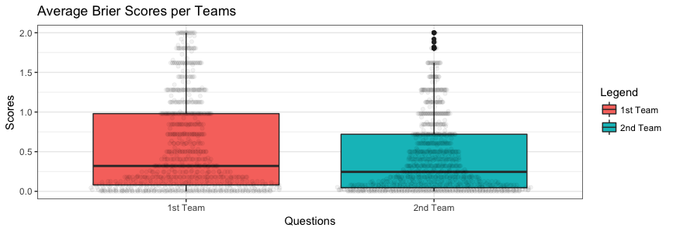
Analysis & Findings
Structured Super-Forecasting
Notes:
In terms of pure scores, with no standardization we can see that in both cases (Avg or Net) Team B prevails in terms of performance

Slide 38
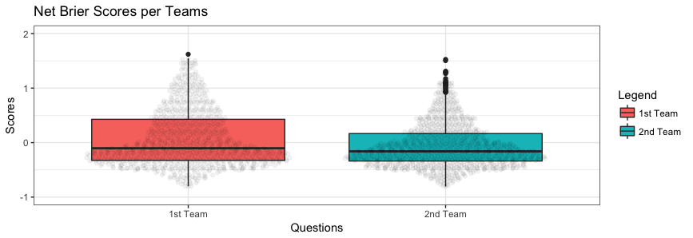
Analysis & Findings
Structured Super-Forecasting
Notes:
In terms of pure scores, with no standardization we can see that in both cases (Avg or Net) Team B prevails in terms of performance

Slide 39
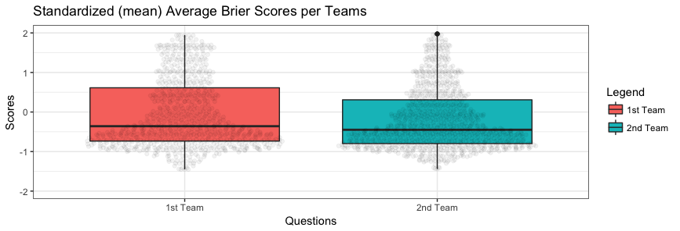
Analysis & Findings
Structured Super-Forecasting
Notes:
In order to further elaborate on the validity of our argument, we perform data standardization with various methods. Initially, we standardize all scores (both Average Briers and NBPs) as a function of deviation from the mean of each question, using the formula: Stand_Value = (x-mean)/SD
This is the key method that we are going to use, although in the respective appendises supplementary information is provided by using various standardizing methods, in order to solidify our arguments….

Slide 40

Analysis & Findings
Structured Super-Forecasting

Slide 41
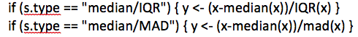
Analysis & Findings
Results were also verified with the following standardizations, as well
Structured Super-Forecasting
Notes:
In order to test the robustness of our results, we have performed the following supplementary standardization methods as well, and in all of them the supremacy of Team “B” performance is being verified (for detailed results see Appendix “….”):
Over Median (IQR): Stand_Value=(x-median)/IQR
Over Median (MAD): Stand_Value=(x-median)/MAD

Slide 42
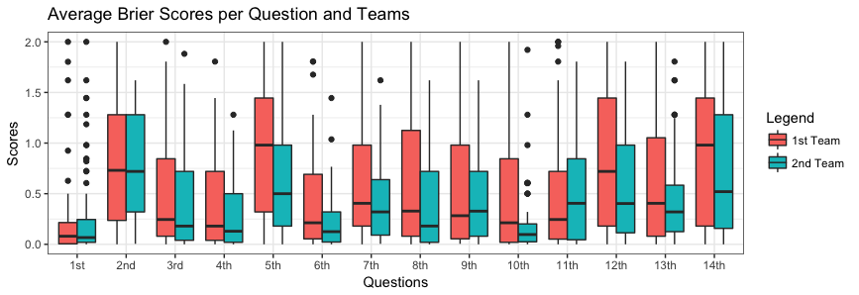
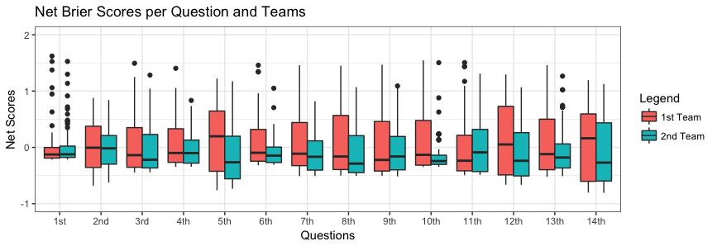
Analysis & Findings
Avg
Net
Structured Super-Forecasting
Notes:
Consistency was also apparent on a question by question basis (with minor exceptions in 1st, 9th and 11th questions), as presented in the following boxplots
(see Appendix “….” for detailed statistics per question):

Slide 43
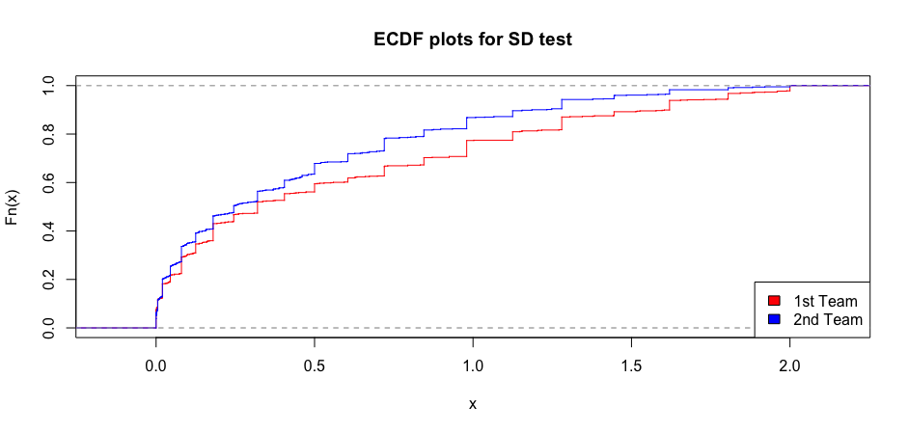
Analysis & Findings
Structured Super-Forecasting
Notes:
Our analysis of the results utilizes, beyond standard measurement concepts of judgmental forecasting, the methodology of stochastic dominance (SD) to evaluate the performance of participants -- for the first time to the best of our knowledge in this strand of the literature. The use of the SD concept is important for two reasons: first, it allows a complete/better view of outperformance compared to more traditional statistics and, second, it provides compelling visuals for the results across individual questions and across any sample split we wish.
SD (Hadar & Russell, 1969) performs a partial ordering between random variables (prospects) for a broad class of decision makers thus revealing the superior prospect. In order to reveal the outperformance of analogies trained teams over the control group, we will use 1st, 2nd and 3rd order SD (Hanoch & Levy, 1969; Whitmore, 1970). The only difference in our approach is that we do not seek to “maximize the profits”, in terms of actual values, but to minimize them, given the lower the Brier Scores, the better the outcomes.
In order to produce and analyze the SD statistics, we perform to our samples (teams per question) two consecutive Bootstrap resamplings as follows:
• Block Bootstraps (100 iterations per Team) in order create new samples with equal numbers of entries.
• Bootstraps for the estimation of P-values, for each of the above produced blocks (20 iterations per block).
By defining as our Null Hypothesis (Ho) that Team “B” does not dominate Team “A”, we derive to the conclusion that, given the p-values for all the comparative statistics presented in the below table, Ho is disproved and therefore Team “B” outperforms Team “A” (The 0.05 threshold for the p-values stands for all levels of SD thus exhibiting the pure outperformance of Team “B”).
All the aforementioned verify our first Hypothesis
Η1: The structured approach for providing forecasts outperforms the unstructured - unaided one (training works).

Slide 44
Hypotheses “21” Testing
Η21: there will be more superforecasters in the extra-trained group
Structured Super-Forecasting

Slide 45
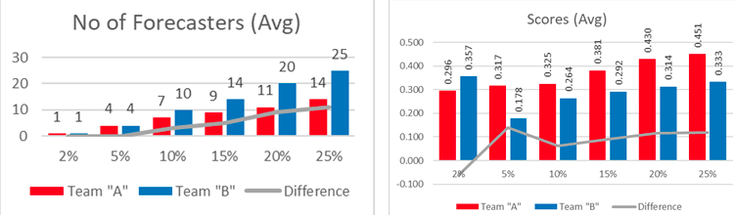
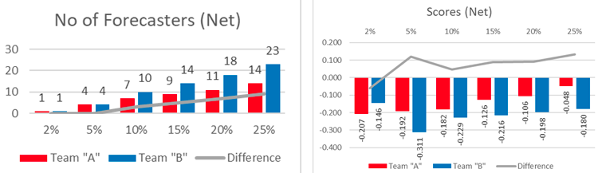
Analysis & Findings
Structured Super-Forecasting
Notes:
In order to test the validity of our 2nd hypothesis, we set as a cut-off point the 6th question, which is the median of our acceptance threshold (11 out of 14 questions to be answered) and we identify, at that point, the forecasters that belong to the top 2% (check validity of Superforecasting theory in the present experimental outline), 5%, 10% and 25% (top quartile) and see who among those remain within the specific pool or we face randomness in performance (time tracking of performance).
We provide below a visual analysis of the above described performance through the following metrics:

Slide 46
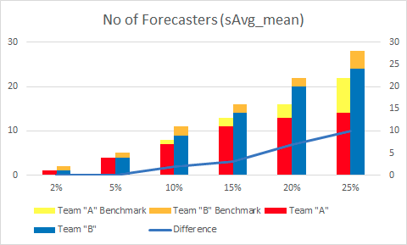
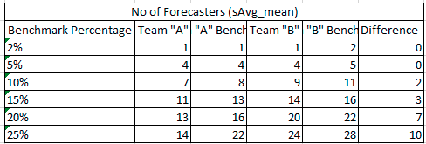

Slide 47
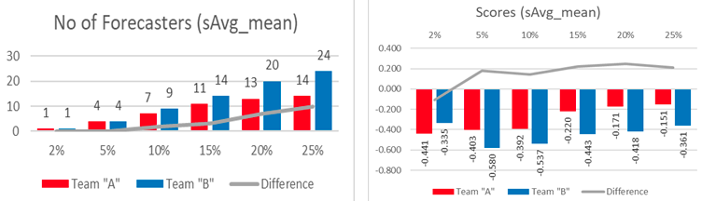
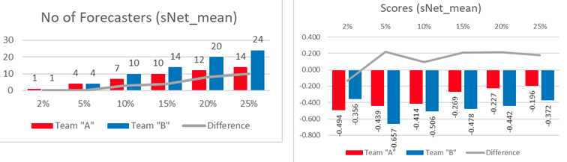
Analysis & Findings
Structured Super-Forecasting
Notes:
The graphs on the left providing the information concerning the number of forecasters per team & per percentage, denote that the trained group (Team “B”) has more systematic “performers”, and the difference between the two groups increases as we increase the respective percentage. The fact that the aforementioned difference changes only above the 5% threshold, should be considered logical and anticipated, given the duration of the experiment and the number of participants. In particular, more systematic research is required, through the use of greater samples, which will identify the critical threshold, where the 2% principle (as per the GJP) starts to apply.

Slide 48



?
kostas@bangor.ac.uk

